Slide 1
CHALLENGE 7 Infectious Swarm
Group 3
Aoshuang wang, lan yao, yixuan huang, lan luo

Slide 2




 | Lan Yao | Aoshuang Wang | Yixuan Huang | Lan Luo
Challenge 1 | Presenter
Challenge 2 |  |  | Presenter
Challenge 3 |  | Presenter
Challenge 4 |  |  |  | Presenter
Challenge 5 | Presenter
Challenge 6 |  |  | Presenter
Challenge 7 |  | Presenter
Challenge 8

Slide 3
 | Lan Yao | Aoshuang Wang | Yixuan Huang | Lan Luo
 | Program Writing | Program Writing &Debugging | Hardware Connection | Program Writing &Debugging

Slide 4
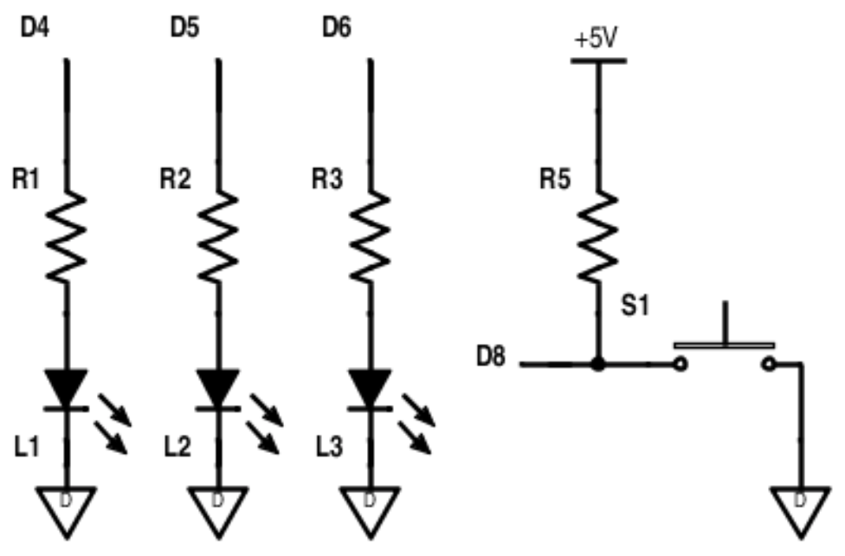
Pressing the button with either start an infection or clear an infection depending on being a leader or a non-leader .
One leader is elected on startup. A new leader is elected if an existing leader disappears.
While infected, each device will send out infection messages to other connected devices.
A clear infection message has priority over infection message.

Slide 5
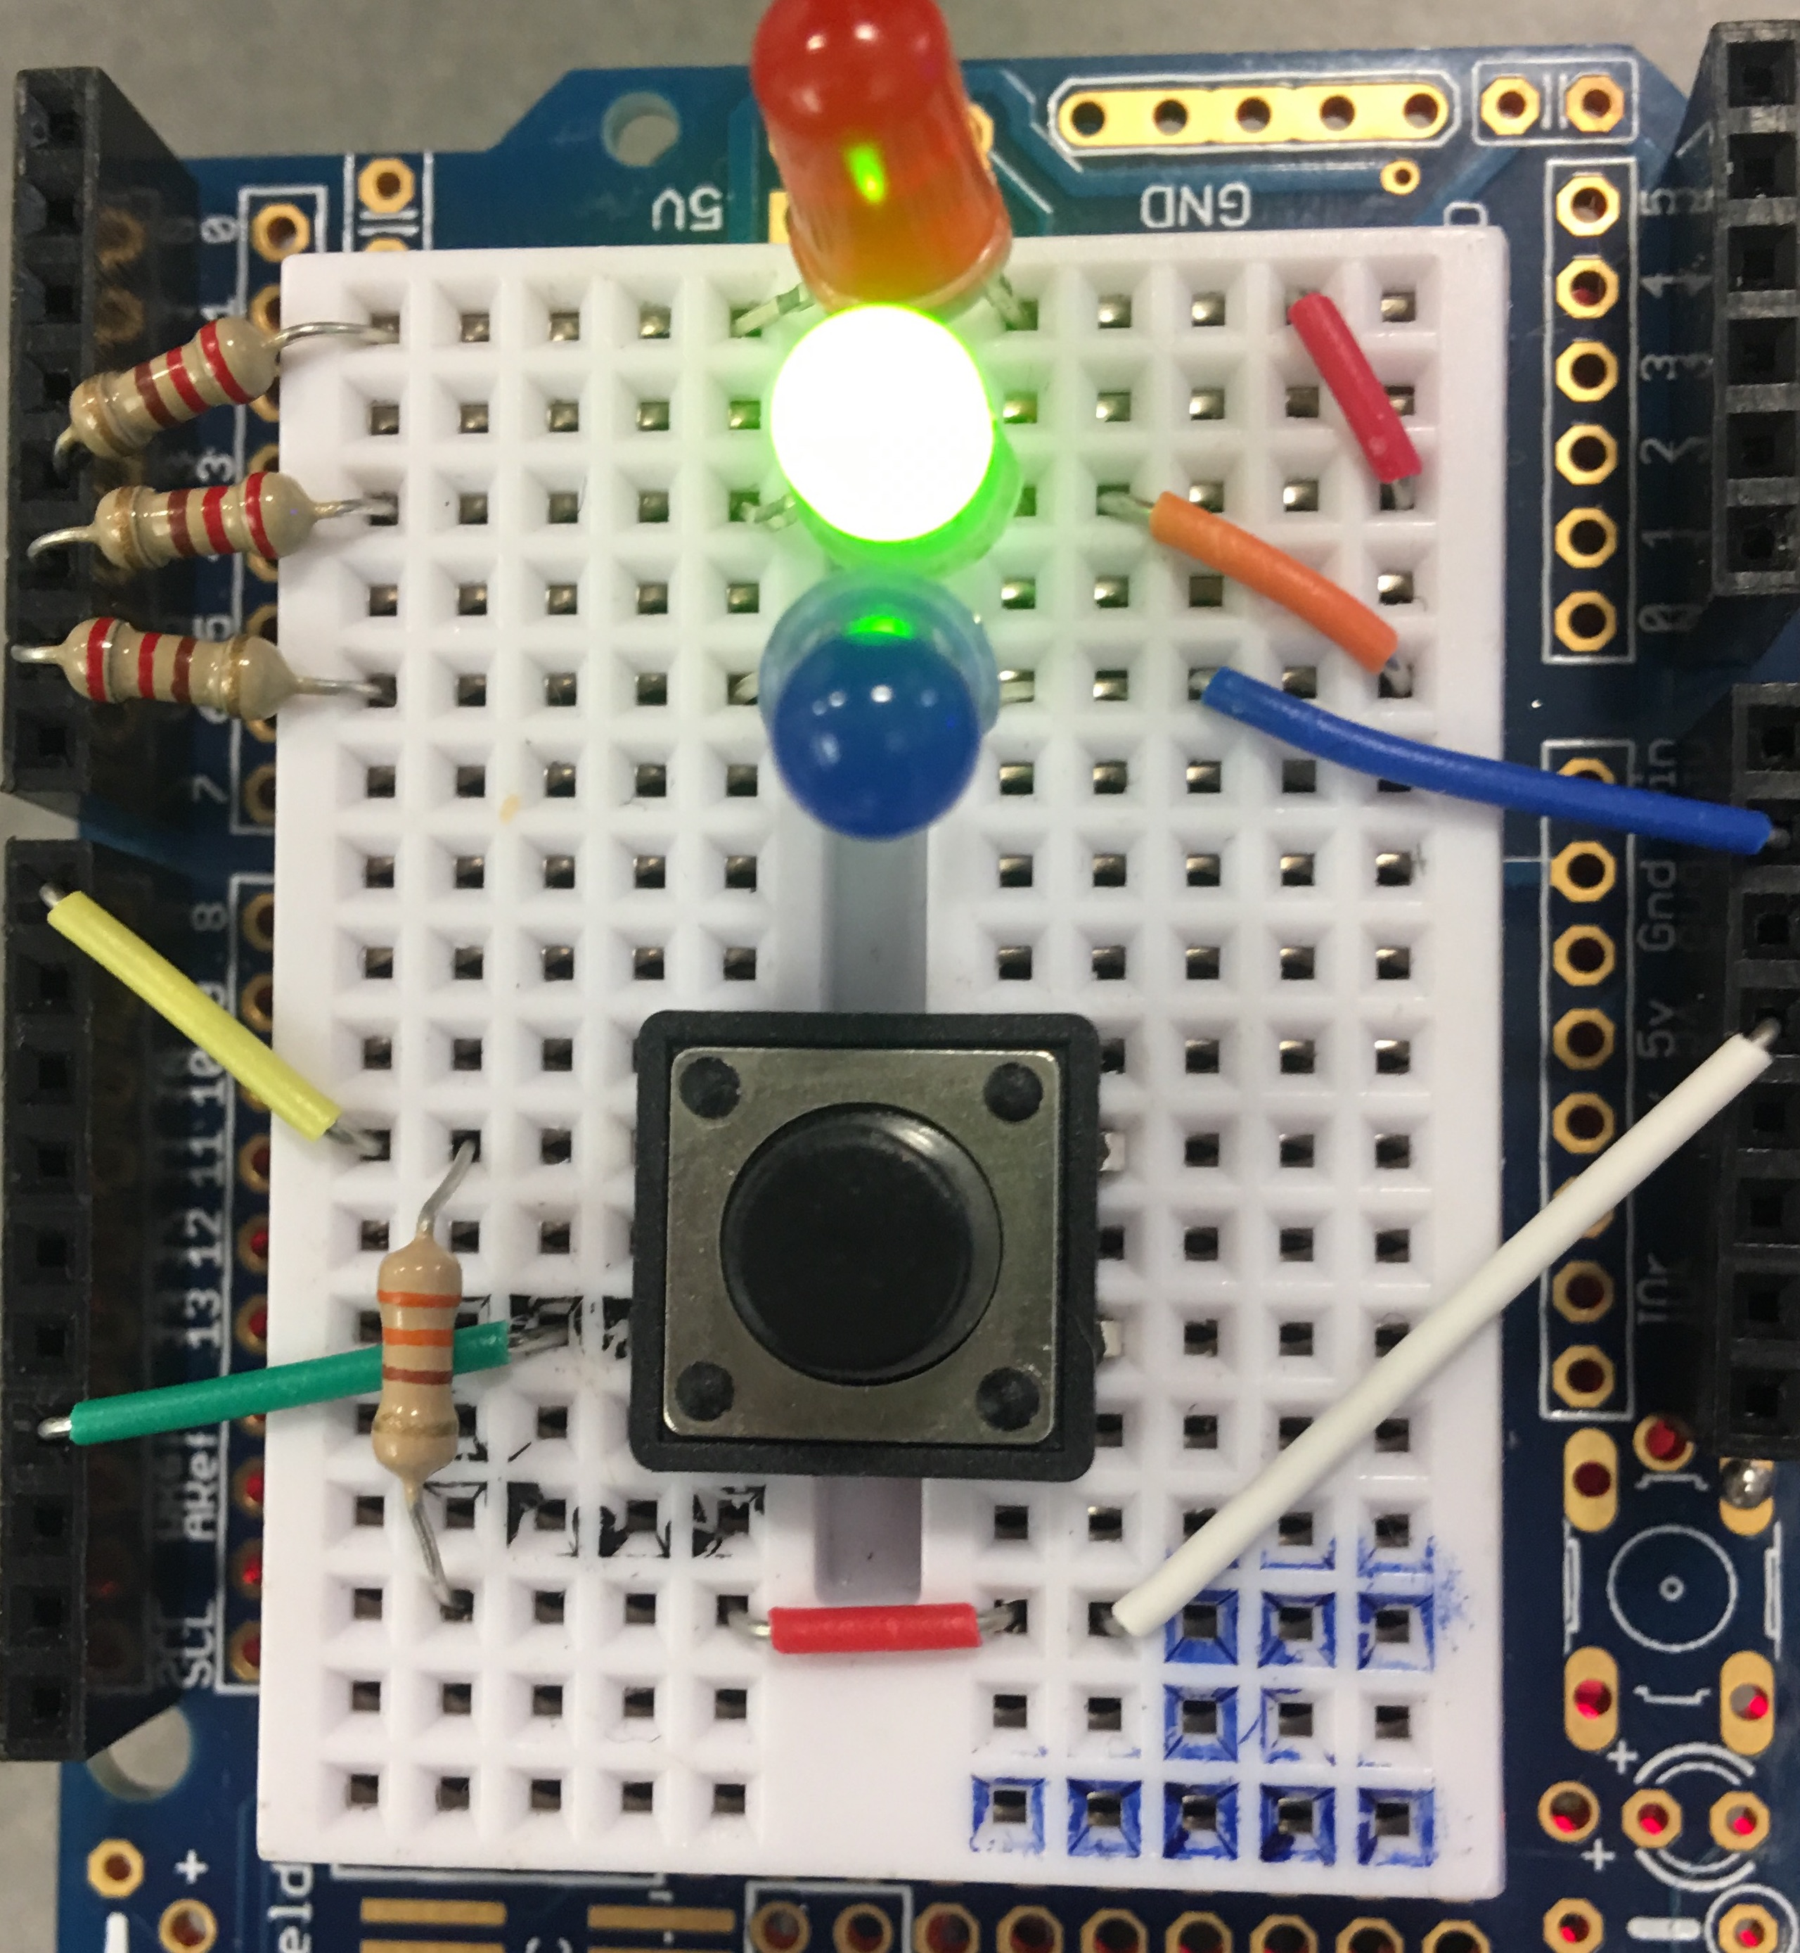
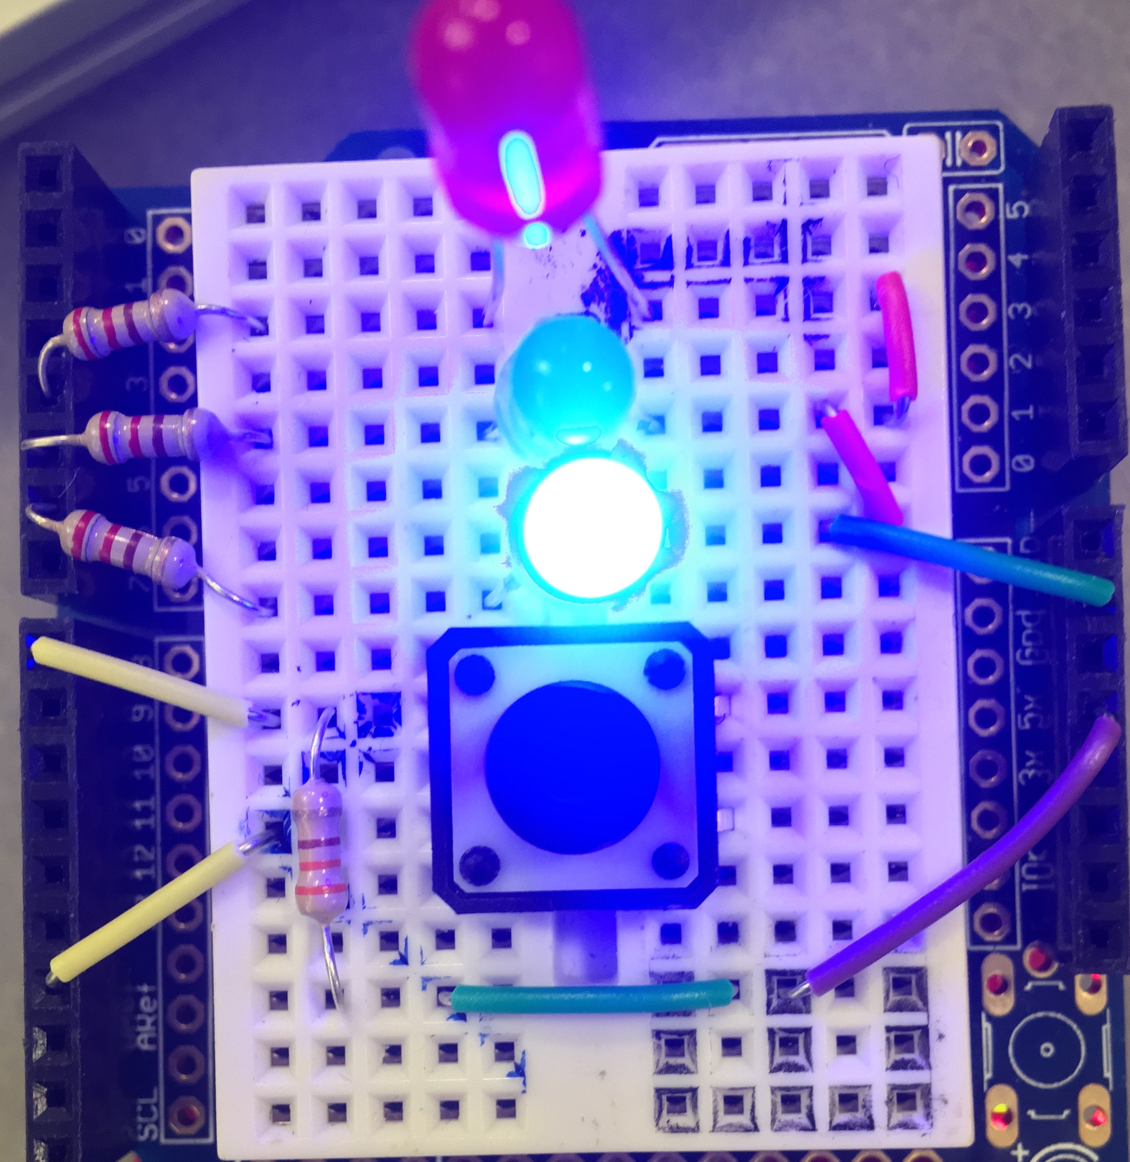
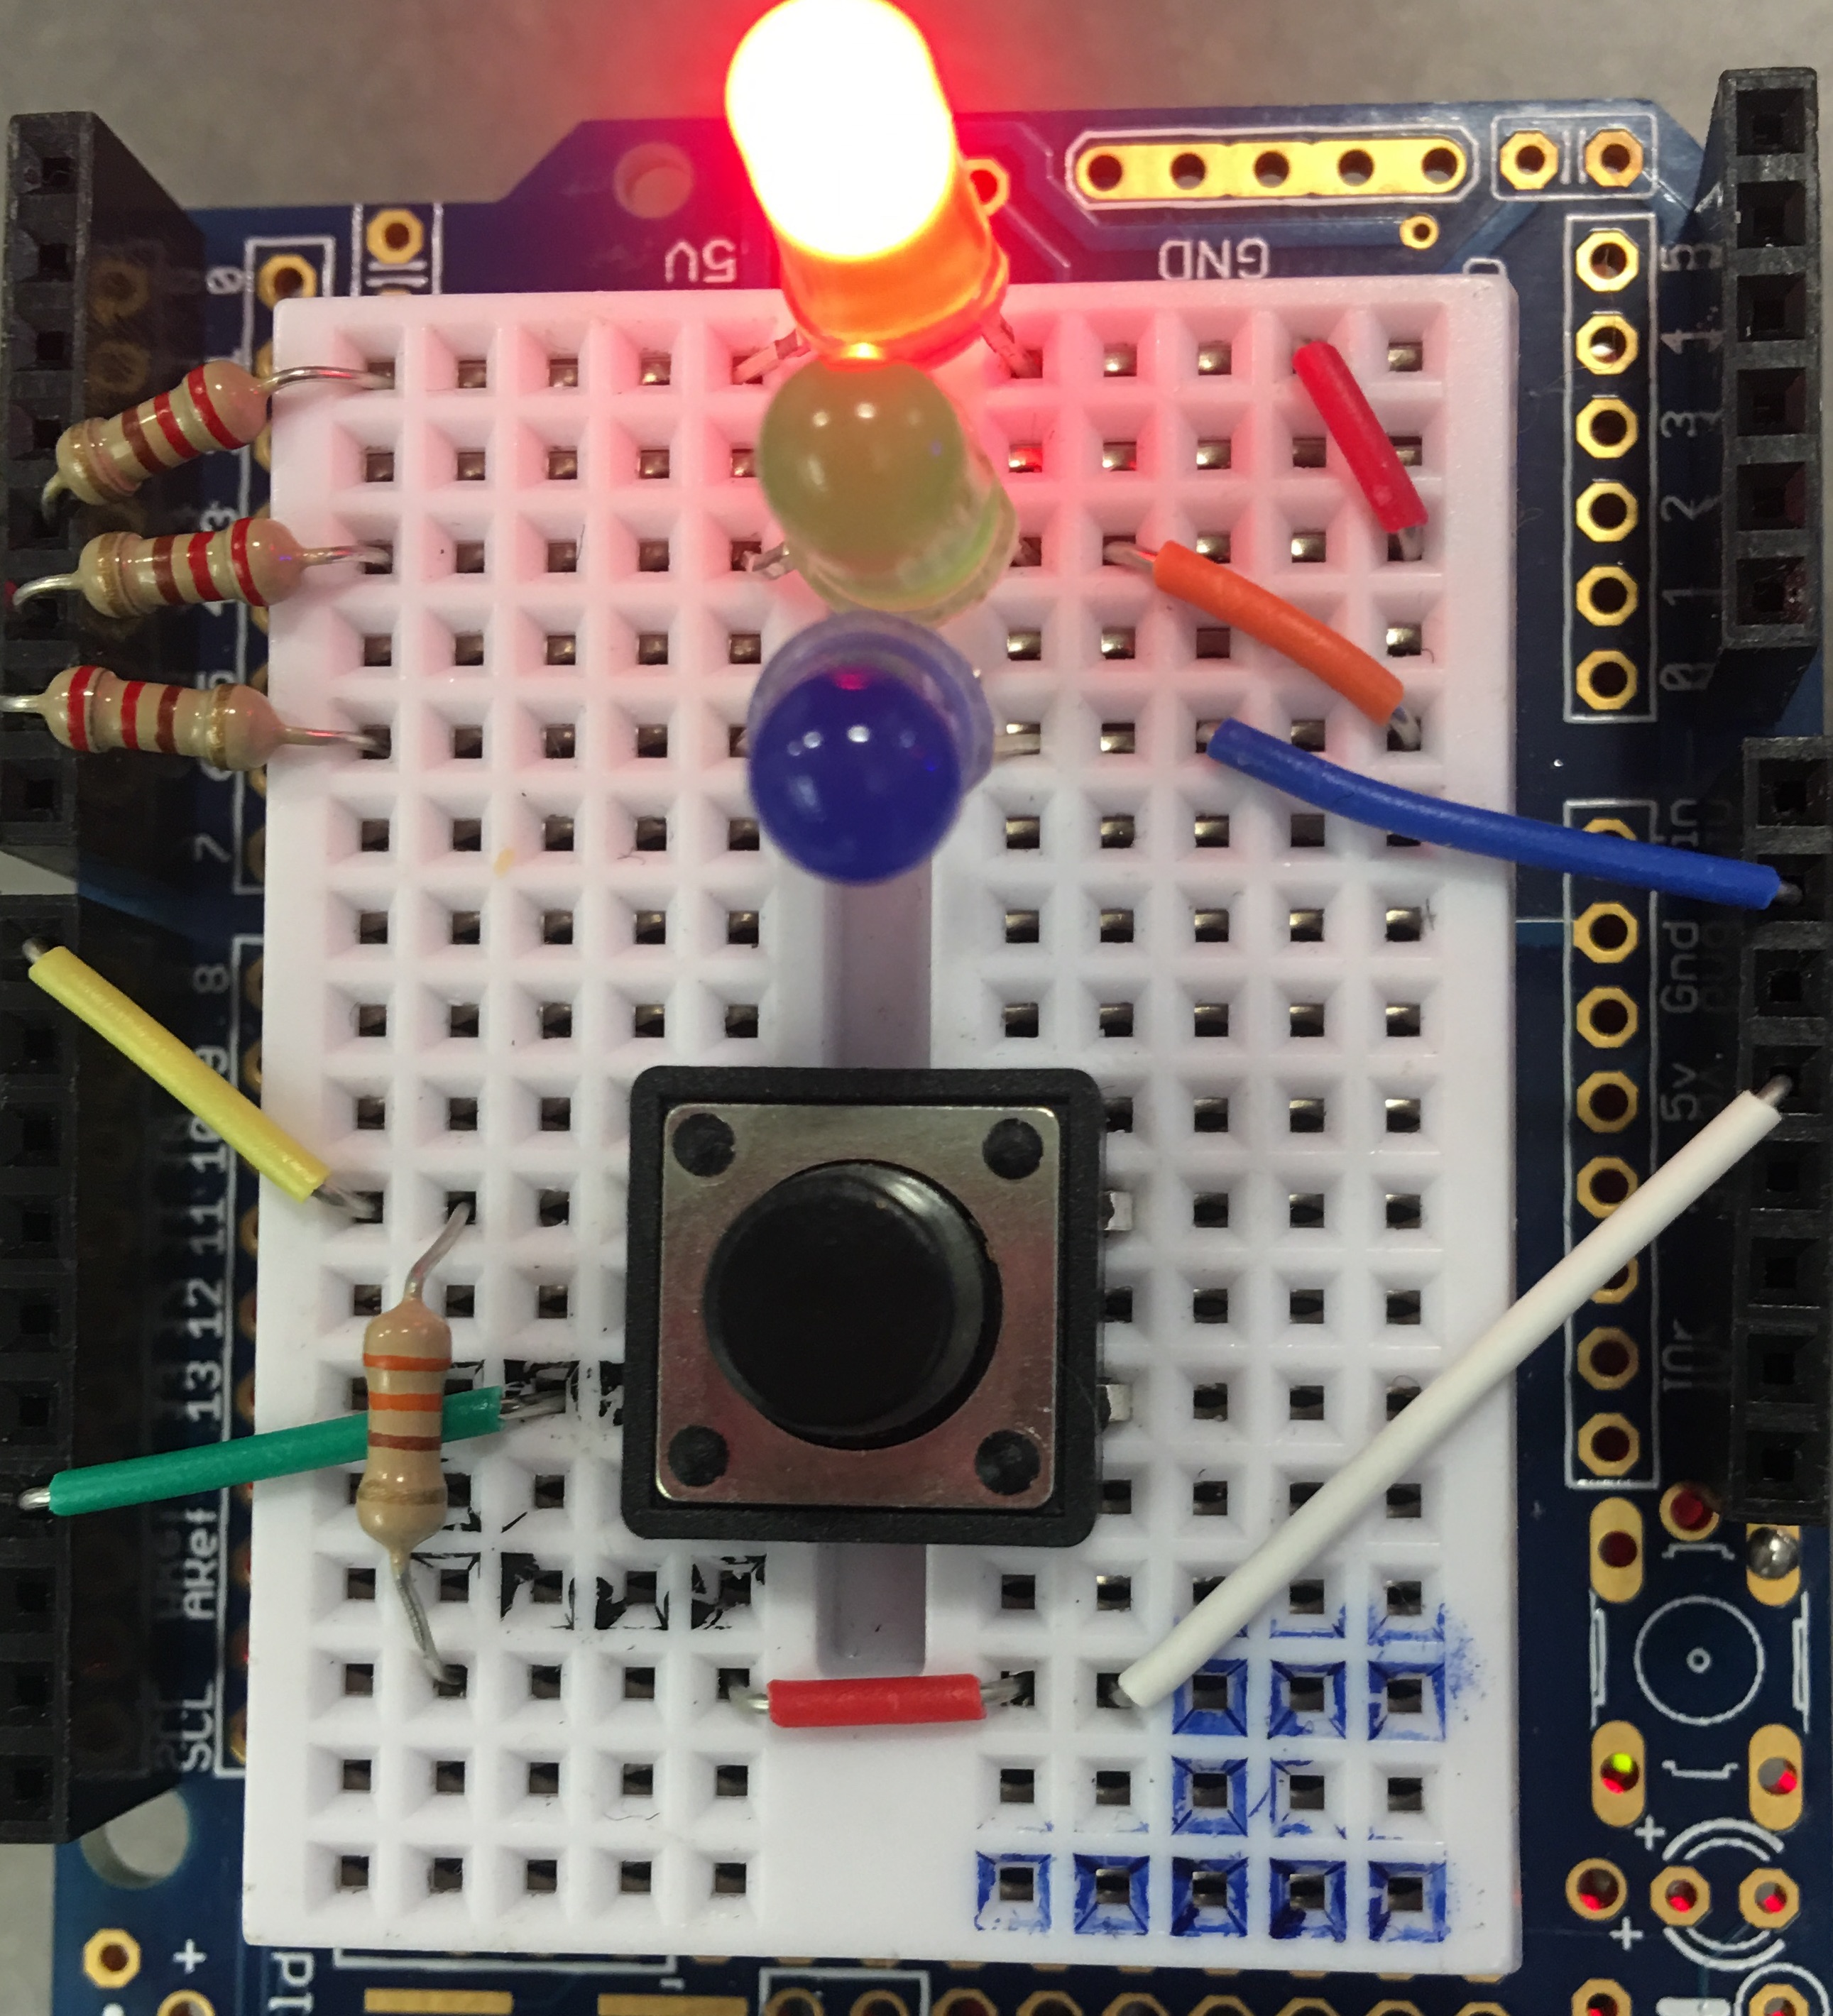
Green : uninfected
Blue : Leader
Red : Infected

Slide 6
Election Algorithm
Bully Algorithm vs Ring Election Algorithm
For Bully Algorithm
Worst case : initiator is with the lowest ID
Triggers n-2 elections at higher ranked devices, n2 messages
Best case : initiator is with the highest ID
Immediate election, n -1 messages
For Ring Election Algorithm
2n messages always
Bully Algorithm:
Any device can initiate an election
Device who initiates the election only sends messages to devices with higher ID
The system is synchronous and uses timeout for identifying process failure
Allows processes to crash during execution of algorithm
Prior information about other process ID’s are known

Slide 7
For each Arduino
We tag every Arduino(XBee) with a unique ID number – serial address.
Maintain a list of addresses of XBees that it can successfully hear from.
Whenever we add a new Xbee into the network, the election system can handle it by adding the address of new Xbees to the tail of the list.

Slide 8
For each Arduino - Messages in payload includes :
DISCOVERYMESSAGE:
Happens when a device is just set up/join the network for the first time
ACKNOWLEDGE:
Happens when my device received a message of “ELECTIONMESSAGE” from other devices
ELECTIONMESSAGE:
Happens when I am the one who starts the election
VICTORYMESSAGE:
Happens when I have won this election
LEADERRESPONSE:
Happens when I am the leader and I have to tell others that I am alive
CLEARMESSAGE:
Happens when I am the leader and my button has been pressed
INFECTIONMESSAGE:
Happens when I am the non-leader and my button has been pressed

Slide 9
For each Arduino - Timers
1000 ms :
Period for hearing replies from other devices
3000 ms :
Period for completing an election when I receive ACKNOWLEDGE
5000 ms :
Period for completing an election when I receive VICTORYMESSAGE
6000 ms :
Period for monitoring leader’s response
3000 ms :
Period for a non-leader getting infected from normal state
4000 ms :
period for a non-leader sending infection message to all non-leaders

Slide 10
Set up
Initial LEDs :
Light up three LEDs
Set up my unique ID
leaderID = DeviceID
Send DISCOVERYMESSAGE
To every device
Start monitoring my response

Slide 11
Loop
Read button state
Use 50ms time interval to debounce
Set LEDs status according to button state as leader/non-leader
Loop
Read packets from other devices and handle them
Record my responses if I am the leader; or start election if I don’t hear heartbeat from leader anymore when I am not the leader

Slide 12
Every Time Receive A New Packet
Receive a new packet
Ensure it is a ZB_RX_RESPONSE
Check if the device has already added into the device list
TRUE
FALSE
inList=TRUE
Add this device into device list
Continue

Slide 13
Discovery
Read packet and receive DISCOVERYMESSAGE
Get Remote ID
Receive the packet data
FALSE
FALSE
TRUE
LeaderID = remote ID
Ask for the correct message to be sent again
leaderID < my DeviceID
TRUE
Begin Election

Slide 14
Clear Infection
Read Pin Button
Present State=Last State
TRUE
FALSE
Did Press The Button & Button State Changes
Break
TRUE
Button State=LOW
TRUE
I am the leader
FALSE
isInfected=True
TRUE
isInfected=False
Send CLEARMESSAGE

Slide 15
Function Start
Begin Election
Is electing now?
TRUE
RETURN
FALSE
Electing=TRUE, Acknowledge=FALSE, countdevice=0
For all devices, is its address higher than my address?
FALSE
TRUE
Send ELECTIONMESSAGE to that device

Slide 16
I am the one who start the election?
ELECTIONMESSAGE
(Send)
NO
YES
Use a for loop to check devices in my list
NO
listID[i] > my DeviceID?
YES
Send ELECTIONMESSAGE
to this ID address

Slide 17
ELECTIONMESSAGE
(Receive)
Get ELECTIONMESSAGE from device A
Send ACKNOWLEDGE to device A
Device A get message ACKNOWLEDGE from that device
Acknowledeged=TRUE
Variable Acknowledged becomes TRUE only if one device is not the leader of the system, which means if we find Acknowledged is FALSE in the main loop, this device should be the leader. Then it can send VICTORYMESSAGE to every device.

Slide 18
VICTORYMESSAGE
Receive VICTORYMESSAGE
newDevice ID> My DeviceID?
FALSE
TRUE
LeaderID = newDevice
Break

Slide 19
LEADERRESPONSE
Receive LEADERRESPONSE
My DeviceID = LeaderID
FALSE
Break
TRUE
newDevice ID> My DeviceID
FALSE
TRUE
LeaderID = newDevice

Slide 20
INFECTIONMASSAGE
Receive INFECTIONMESSAGE
LeaderID = My Device ID?
TRUE
FALSE
isInfected=TRUE
Break

Slide 21
Challenge
Use millis() for multitasking.
Learning about leader election algorithms.
Set up Xbee API firmware.
Election according to address.
Optimize delay.
Synchronous issue in distributed election system.

